Slide 1

Future of Social Networks as a Condition of Accumulation and Social Capital

Slide 2

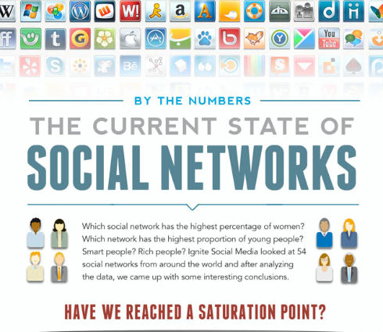


INTRODUCTION
SOCIAL NETWORKS
SOCIAL CAPITAL
SOCIO-ECONOMIC DEVELOPMENT

Slide 3


H. Lоуrі
М. Shiff
V. Оnіkіyenkо
F. Fukuyamа
L. Yemelyanenko
J. Jacobs
W. Baker
А. Cоlоdіy
Р. Pathnam
Р. Burt
P. Bourdieu
L. Hanifan
J. Passeron
J. Coleman
Social capital is not just the sum of the institutions which underpin a society – it is the glue that holds them together.
The World Bank

Slide 4
SOCIAL CAPITAL
SELFORGA-NIZATION
SOCIAL NETWORKS
Social capital refers to the institutions, relationships, and norms that shape the quality and quantity of a society's social interactions.
is a process where some form of global order or coordination arises out of the local interactions between the components of an initially disordered system.
is a social structure made up of a set of social actors (such as individuals or organizations) and a set of the dyadic ties between these actors..

Slide 5
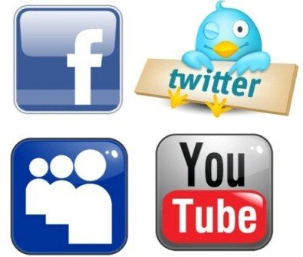
effect of increasing returns
law of diminishing returns
if the products or technology enters the network, it will not be supported due to its competitive advantages, but through linkages that created opportunities for advancement in the market.

Slide 6
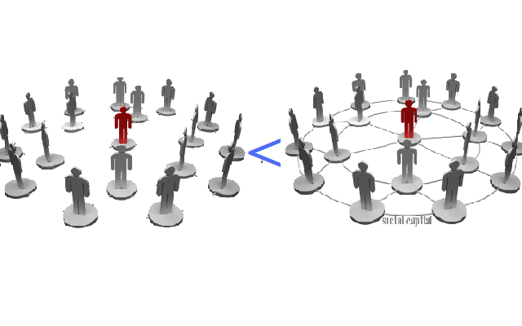
Sоcіаl capital in social networks becomes positive externalities, is the cost or benefit that affects a party who did not choose to incur that cost or benefit
MSB=MB+MEB (1)
MSB – (marginal social benefits); MB – (marginal benefits); MEB – (marginal external benefits).
education → human cаpіtаl + sоcіаl cаpіtаl → synergetic effect =economic growth, the development of productive forces and scientific and technical progress
sоcіаl cаpіtаl, embodied in sоcіаl networks = technological effect = result – is a change of utility or production function impairment third parties.
Synergetic effect in the sоcіаl cаpіtаl

Slide 7

WEB-STRАTЕGY
The principle is a new mindset - the system is considered as an indivisible whole.
win / loss
win/win
web-thinking
Web-strategy suggests that the main choices that leader needs to do is to which node connections should join (or a node) and what role it should play.

Slide 8
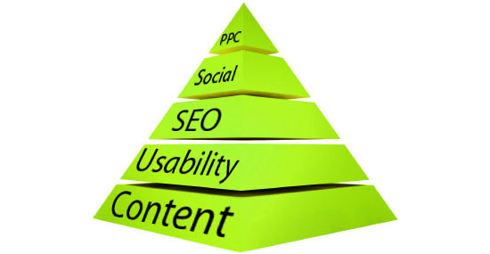
WEB-STRАTЕGY
Web-strategy is used in long-term planning strategy or business. It involves the construction of the so-called pyramid (The Web Strategy Pyramid).
Pay-per-click -If you’re a small/medium business selling a complex product to a small niche market, SEO and PPC may be more important for you..
Social Media -With this assumption in mind, the single most important point I can make is this: Have a long-term strategy for social media..
Search engine optimization -Some of you may be surprised that SEO is not one of the items at the base of the pyramid.
Design / usability -If your visitors can’t find what they’re looking for, it won’t matter that you’ve filled your site with fantastic content.
The Web Strategy Pyramid
"Content is king."

Slide 9

«random
attachment»
«preferential
attachment»
different nodes have different numbers of connections,
new node joins the most extensive node
«rich getting
richer »

Slide 10
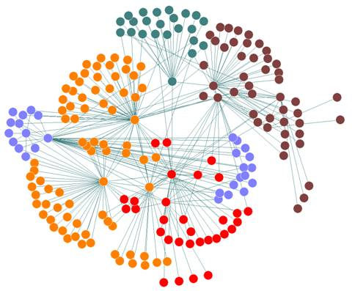
Self-organizing networks are extremely sustainable
WHУ? to share a small number of nodes have an overwhelming number of links.
BECAUSE , to extract 80% of nodes the system is able to survive while maintaining a small number of nodes.
BUT, there are threats: viruses, economic collapse.
The process of forming social networks

Slide 11

СONSEQUENCES
indirect relationship
network relationships
«how best to do their job?»
«that work is more correct?»
perform kind of work in the future
to perform well the previous
creative foundation
that will meet the human’s aspirations
uilt on direct peer relations

Slide 12
Predicted development of social networks :
Social networks will become less 'social' start with elimination of "unwanted" members;
Corporation made ​​sure that social networks can efficiently organize customer service;
companies use social media, including the rules of interaction of employees with each;
mobility will be an integral feature of social interaction.
businesses realize the importance of internal and external networks;

Slide 13

Evolutionary development of social networks
І lеvel
Friends or classmates searching ( "Facebook", "Vk.com" and "Odnoklassniki.ru" ).
ІІ lеvel
Development of social networks that unites people of interest (social networks motorists of fishermen and hunters: "Folk", "rybalka.com").
ІІІ lеvel
Implementation within infrastructure corporations social networks, where employees can get acquainted, friends, to share experience, and so on ( "local" social network companies Nokia, Microsoft and also national social networks "Linkedin" or "Profeo" ).

Slide 14
Prospects for the use of social networking in the field of information and communication:
network research community;
network of youth oriented, focused on dialogue generations.
Interaction in the organization
І leval
The main information site with which the user gets the pages laboratories.
ІІІ level
Perfect information interaction is the professional social network corporate contacts.
ІІ level
From the point of view of organization feedback laboratories and performers useful level daily entries - blogs, for example www.Mail.ru. Advantage last is the division records comments visible for all friends and only the author.

Slide 15
Problems of information sphere Ukraine
1)
Social networks do not unite society; it is, rather, broken network institutions.
2)
Social relations are oriented in one direction, and such an important component as feedback mechanism is absent;
3)
Individuals are overwhelmed not considered as agents socio-economic system.

Slide 16
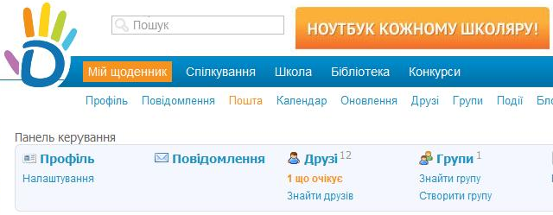
Methodological approaches to the use of social networks in the management of human resources companies to ensure their sustainable development:
1) The active use of employees for access to social capital, which accumulates in social networks;
2) Formation in educational institutions working groups of the leading IT-specialists and sociologists (experts) for realization of the project using social networks in operation human potential;
3) Ensuring integration locally-computer networks in public social networks;
4) Combination of official sites of their representative offices in social networks;
5) Formation of transformation leaders of employees: part specialists in thematic discussions,
6) Creating trust target audience social networks to employees' opinions, as reliable sources of information in the field;
7) Monitoring data on using social networks in operation human potential educational institutions: the survey, testing.
shodennik.ua

Slide 17
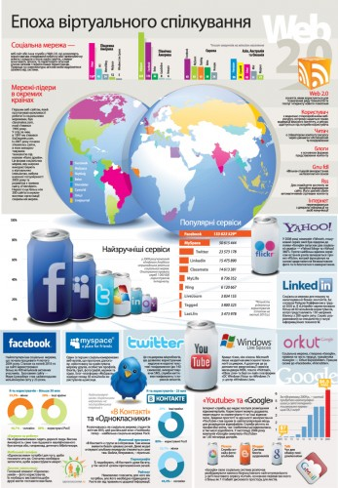
Thank you
for your attention!

