Slide 1
Center-periphery relations and connections: regional dimension

Slide 2
The rearrangement of social and economic space requires rapid administrative solutions based on reliable scientific and practical approach. In the majority of modern programs of region and state development the control objects (of region, district, city) are generally considered as simple simplexes, inherently homogeneous objects. At the same time the spatial organization of administrative units belonging even to the lowest rank are notable for complexity, multifunctionality, essential internal differentiation. Modern general conception of state management must be oriented to solve objective issues of social and economic inequality both in public (social stratification) and space aspects.

Slide 3
Modern geographical science enlightens prevailingly phasic and territorial conceptions of central and peripheral development for separate macroregions and the world in general. Additionally, the “center – periphery” links can be easily observed on the state and regional levels. In Ukraine modern theories and conceptions of social geography are prevailingly addressed to the issues of regional development. During the analysis of geospace differentiation one always deals with fundamental study and assessment of internal natural, economic, scientific, labour potentials of each region. Such research shows the universal character of “center – periphery” type of models in order to describe the polarization of geographical space and its separate components.

Slide 4
The following provisions can be regarded as the starting point of conceptual perception of “center – periphery” type of systems:
1. “Center – Periphery” is a fundamental category which characterizes the set of hierarchical order of geographical objects and explains the heterogeneity of geospace. The internal (genetic) order of geospace triggers the hierarchy of geographical objects concerning their spatial organization. Thus the “center – periphery” category can be considered as an extent of geospace hierarchy.

Slide 5
2. The “Center – Periphery” category has topological character. The main topological character of geographical objects in geospace is a location. Geospace is a sum (integral) of locations. Location differentiation triggers its hierarchy which is reflected in central and peripheral organization of geospace. From genetic point of view the Center is an advantage in location system, and the Periphery is a disadvantage. Thus Center and Periphery are topologically based.
3. The development and interaction between Center and Periphery are accomplished according to the rules of self-organization and synergetics. The difference of locations of geographical objects triggers their interaction. According to the system conception it’s the self-organization of set of geographical objects which is reflected in forming geosystems and geocomplexes. Thus central and peripheral organization of geospace is the result of self-organization and extent of its development.

Slide 6
4. From genetic point of view topological category “Center – Periphery” acquires metric characteristics during its development: original Centers and Peripheries fix the difference of locations, show the extent of order and self-organization of geospace; afterwards they are changed as a result of superposition of such metric characteristics as demographic, infrastructural, economic, social potentials etc.
5. One should differentiate Center and Periphery between basic (natural, geospatial) and derivative (artificial, administrative). The first one is a result of topological and, consequently, metric heterogeneity and self-organization of geospace, while the second one is a result of socially conscience converting the locations with certain topological and metric characteristics into those having central or peripheral functions. It’s noteworthy that in case of discrepancy of artificial and natural Centers and Peripheries the latter option often requires the intensification of administration and the use of specific social, economic, politic control levers.
6. Multifunctionality and hierarchy of geospace triggers the multifunctionality of “Center – Periphery” type of system. It also causes the issue of superposing functions in locations with certain topological, metrical and administrative characteristics. The prime cause of such a problem is the specific diversity of Centers and Peripheries, the specific intensity of geospace relatively its location. Such a superposition can be constructive and destructive, and in case of constructive superposition one can often observe synergetic effect in the system development.

Slide 7
To identify the spatial features and regularities of “Center – Periphery” systems on the region scale we chose Ukrainian Black Sea Region. The main method of spatial analysis was topological approach. The essence of such an analysis is based on the following provisions:
1. Topological analysis provides the greatest result in social and economic research when applied to topological geospaces with high level of coherence. The example of such a geospace is Ukrainian Black Sea Region and neighboring regions. The research covers such regions as Odessa, Mykolayiv, Kherson Regions and their neighbours Vinnytsia, Kirovograd, Dnipropetrovsk, Zaporizhya Regions. Despite the fact, that the Autonomic Republic of Crimea in the majority of Ukrainian regionalization schemes, together with Mykolayiv, Odessa and Kherson Regions, is generally included into the same taxon (Black Sea or Southern economical/social geographical area), in this paper we exclude it from the research area. Such approach is determined by the specificity of this Ukrainian administrative territorial unit, especially by its geographical peninsular location.

Slide 8
2. Selection of operational territorial units for research. As operational territorial units (OTU) we selected administrative territorial units - districts of the regions and towns of regional subordination, totally 196 units.

Slide 9
3. Selection of metric characteristics of analysis and their transformations. In terms of assessing the complex of social and economical characteristics comprising different blocks of the "quality of population life" category (by I. V. Hukalova), we ranked the administrative territorial units. We selected the following main characteristics of social development: migration balance as the indicator of social economic attractiveness of operational units, population amount per 1 worker, rate of the average employees' salaries, investment to fixed assets (per 1 person), number of small enterprises (per 1000 people) and unemployment rate (%), retail turnover (per 1 person) and volume of services supplied to the population (UAH). The mentioned indices were further ranked, besides the highest rates corresponds to the 1st rate, the next one – to the 2nd, the lowest – the 196th. We took into consideration the equality principle of the selected social and economical indices, that’s why on the basis of received ranks we deducted the integral social development rank formed by the influence of the above mentioned factors (the arithmetical mean of the rank coefficients of the operational units due to above mentioned indices). Thus, we got the nominal metric geospace at this research stage.

Slide 10
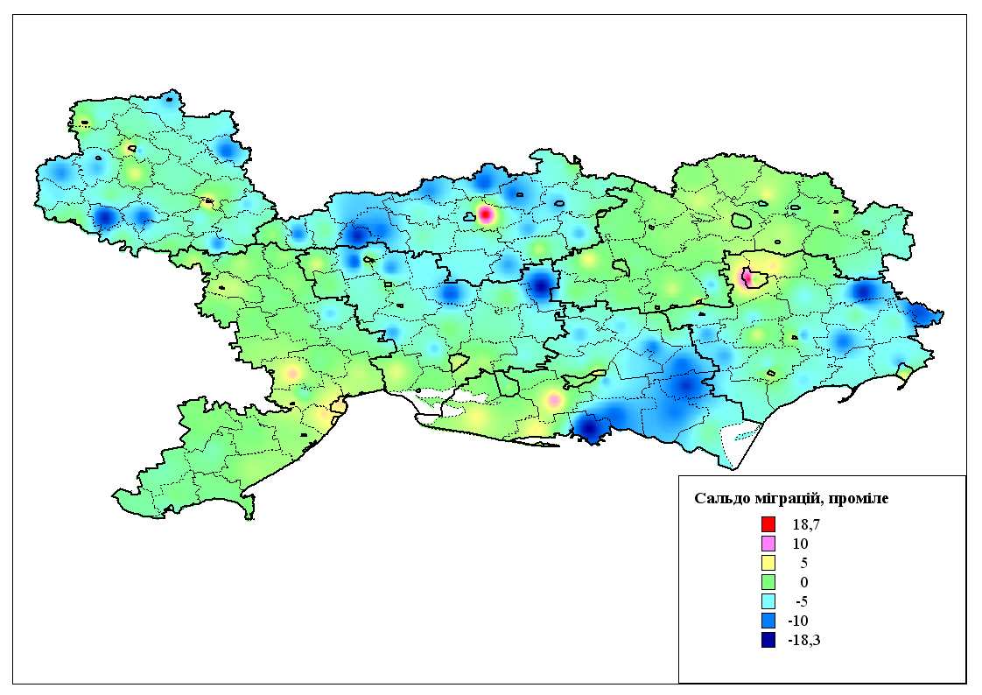
migration balance (per 1000 people)

Slide 11
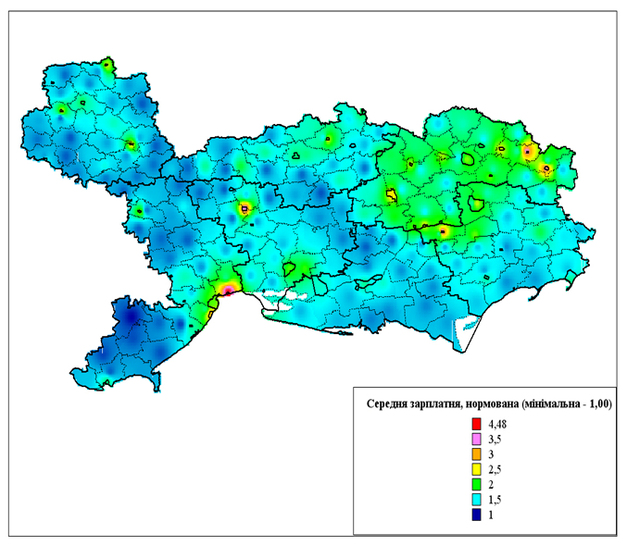
rate of the average employees' salaries

Slide 12
4. Reasoning of the compound analysis methods of nominal geospatial properties and geospatial topological characteristics. Taking into consideration the such topological geospatial property as coherence and results of the previous research stages while reasoning of such methods, we determine the following basic statements: a) topological distance (the neighborhood rank) appears as a space unit; b) the complex of OTU of the same topological distance forms topological “stripes”: Center – prime stripe, the 1st rank neighbours – the 1st stripe and topological “stripes”; c) the topological stripe gets the value of integral social development rank as an arithmetical mean of OTU analogous comprising values. Thus, the offered approach allows to combine benefits of topological and metric geospatial measurement. The results of the topological analysis are presented in tables 1 and 2.

Slide 13
Table 1
Social development rank indices of the administrative units
at different topological distances from region centers
Region | Center development rank | Generalized social development rank indices of the administrative units at different topological distances from region centers
 |  | Distance 1 | Distance 2 | Distance 3 | Distance 4 | Distance 5 | Distance 6 | Distance 7
Vinnytsia | 5 | 38 | 104 | 111 | 102 | 92
Dnipropetrovsk | 10 | 11 | 69 | 95 | 67 | 134
Zaporizhya | 12 | 58 | 109 | 142 | 116 | 90
Kirovograd | 20 | 21 | 137 | 112 | 114 | 124
Mykolayiv | 3 | 65 | 122 | 112 | 104 | 188
Odessa | 1 | 14 | 66 | 101 | 152 | 158 | 82 | 158
Kherson | 17 | 40 | 72 | 136 | 134

Slide 14
gradient
(changes of a peripheral index per distance unit)

Slide 15
Table 2
Change of social development ranks through peripheral region stripes
Directions | Social development rank at the topological distance
 | Center | 1st | 2nd | 3rd | 4th | 5th | 6th | 7th | 8th | 9th | 10th | 11th | 12th
Odessa-Vinnytsia | 1 | 31 | 167 | 109 | 195 | 171 | 168 | 129 | 88 | 59 | 38 | 5
Odessa-Mykolayiv | 1 | 9 | 41 | 78 | 3
Mykolayiv-Kherson | 3 | 47 | 51 | 17
Kherson-Zaporizhya (right bank) | 17 | 51 | 70 | 118 | 65 | 149 | 50 | 12
Zaporizhya-Dnipropetrovsk | 12 | 50 | 95 | 11 | 10
Dnipropetrovsk-Kirovograd | 10 | 11 | 101 | 131 | 100 | 124 | 21 | 20
Kirovograd-Vinnytsia | 20 | 21 | 99 | 182 | 112 | 174 | 74 | 79 | 154 | 61 | 79 | 38 | 5
Kirovograd-Mykolayiv | 20 | 21 | 136 | 93 | 186 | 71 | 47 | 3
Kherson-Zaporizhya (left bank) | 17 | 29 | 104 | 135 | 113 | 156 | 132 | 73 | 50 | 12

Slide 16
the description of the morphology of social economical indices outline in administrative territorial units, implemented in “Center 1 – Center 2” directions through the peripheral area

Slide 17
5. Topological analysis of “Center – Periphery” systems. According to the results of the previous research stages, a topological geospace transforms itself morphologically from the net structure into linear one, where the topological distance is a unit of distance. The further research of “Center – Periphery” multilevel geosystems is possible in directions of the analysis of the following parameters of periphery changes (as transition parameters from Center to Periphery), among which we should emphasize: a) the description of the morphology of social economical indices outline in administrative territorial units, implemented in “Center 1 – Center 2” directions through the peripheral area; b) capacity – the number of "spheres", "stripes” of administrative territorial units comprising Periphery; c) gradient (changes of a peripheral index per distance unit).

