Slide 1
Distance Learning System «KSU Online»
prof. Alexander Spivakovsky
First-vice rector of Kherson State University
Kherson, Ukraine

Slide 2
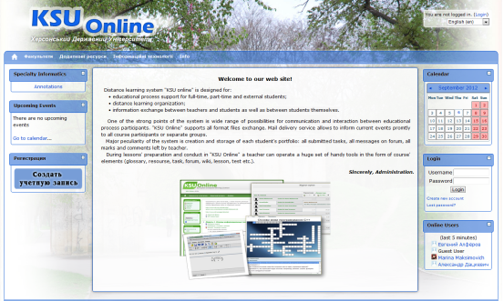
DLS «KSU Online»
Distance Learning System «KSU Online» was designed for:
Training support for full-time, extramural and external-degree students;
Distance learning introduction;
Information interchange between students and academic staff.

Slide 3
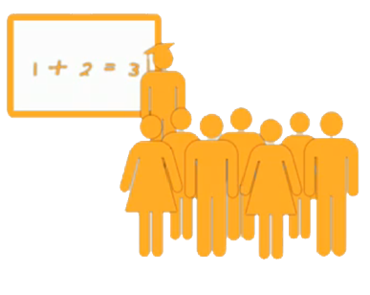
KSU Online Maintainces
Various models of e-learning & teaching styles

Slide 4
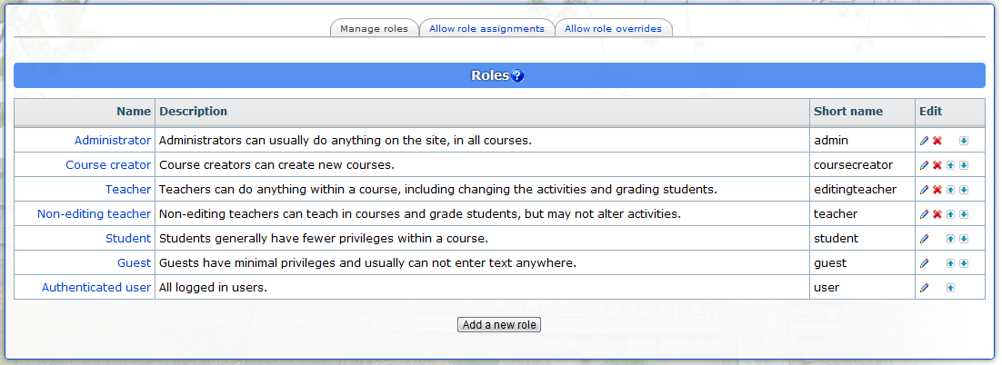
Roles
Administrator
Lecturer
Unregistered Instructor
Student
Guest

Slide 5
Opportunities of Registered Users
Calendar
Accounts Viewing
Personal Data Change
News Overview
Teaching Courses Viewing

Slide 6
Opportunities of Students
Personal Data Change
Forum, chat
Resources Overview
Tests and Quizzes
Resources Saving
Own Grades Viewing
Assignments’ Fulfilling

Slide 7
Resources Viewing
Resources Editing
Lecturer
Overviewing
Courses Adjustments’ Change
Users Registration for Courses
Cooperation with Students
Groups’ Creation
Groups’ Management
Adjustments’ Change
Work with the Register
Evaluation
Unregistered Instructor

Slide 8
Instruments
KSU Online
Resource;
Lecture;
Assignment;
Copybook;
WIKI
Work sheet;
Calendar;
Glossary;
Explanations etc
Survey;
Test;
Grades;
Chat;
Forum;
Database etc

Slide 9
Additional Opportunities
An Opportunity to Define
Deadline
It is Possible for Every Assignment to
Use forum
The Lecturer Allows to
Correct Answer for Repeated Evaluation
Max Grade
Answer Format
Evaluate
Comment

Slide 10
Copybook
1
2
3
Private contact between student and lecturer
The lecturer may evaluate every note for the whole group and for every student separately
Lecturer’s comment is added to the assignment (+ automatic e-mail notification).

Slide 11
Copybook
Generation of databases in
web-interface with МS Word
Multiple use of questions
in different tests
Automatic evaluation and revaluation
Time constraints possible
Attempts limit possible
The grade is automatically put into the register

Slide 12
For the Lecturer’s Convenience
Hot Potatoes is a quiz authoring program that creates questions that can be imported into Moodle in Quiz module, Lesson module and Hotpot modules.
Formula editor
Template for quiz
Crossword Forge combines lightning speed and unmatched flexibility to construct eye-catching puzzles with ease.

Slide 13
Go to http://ksuonline.ksu.ks.ua

Slide 14
Thank you for attention!
Kherson
ul. 27, 40-Rokiv Zhovtnya
http://www.ksu.ks.ua
e-mail: office@ksu.ks.ua,
tel. (0552) 22-62-63
fax (0552) 49-21-14

